Slide 1
CROWD-TRACK: REAL-TIME MONITORING AND HEATMAP GENERATION SYSTEM FOR CONFERENCE HALLS

Slide 2
What is the AI Crowd Tracking Subsystem?
1
Detects and counts individuals.
Merges Model to NIVIDIA JETSON NANO.
4
2
Identifies entry and exit points.
Output: Live crowd insights via web interface.
5
3
Tracks movement & generates real-time heatmaps.

Slide 3

Physical Components
NIVIDIA jetson
Keyboard,Mouse,
Monitor
PC or Laptop
Fisheye camera

Slide 4
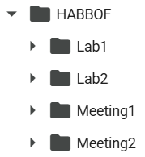
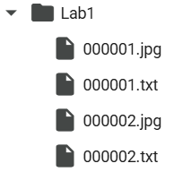
HABBOF
(Human-Aligned Bounding Boxes from Overhead Fisheye Cameras)
Made by: Boston University (VIP Lab), 2019
Videos: 4 indoor videos (computer lab & meeting room)
People: 3–4 people doing daily activities (walking, sitting, writing)
Frames: 5,837 labeled images
Camera: Fisheye cameras mounted on the ceiling
Goal: Use rotated boxes that match the direction a person is facing
📚 Cited in: Li et al., AVSS 2019

Slide 5
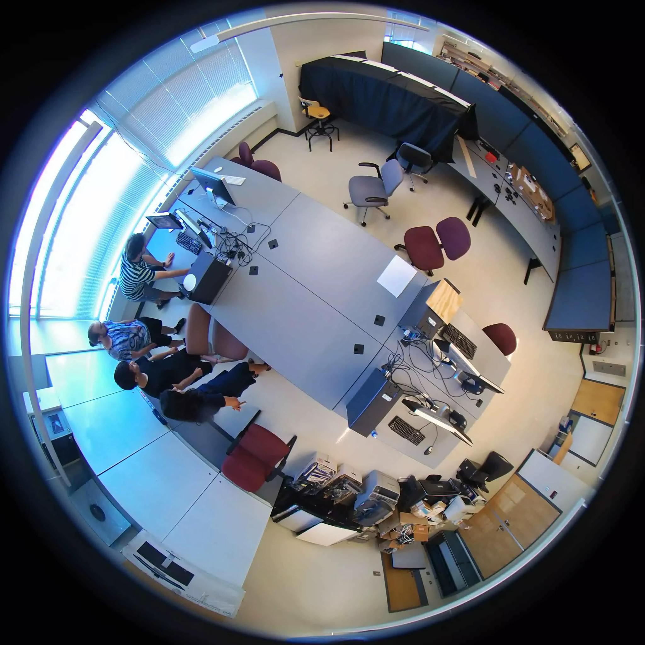
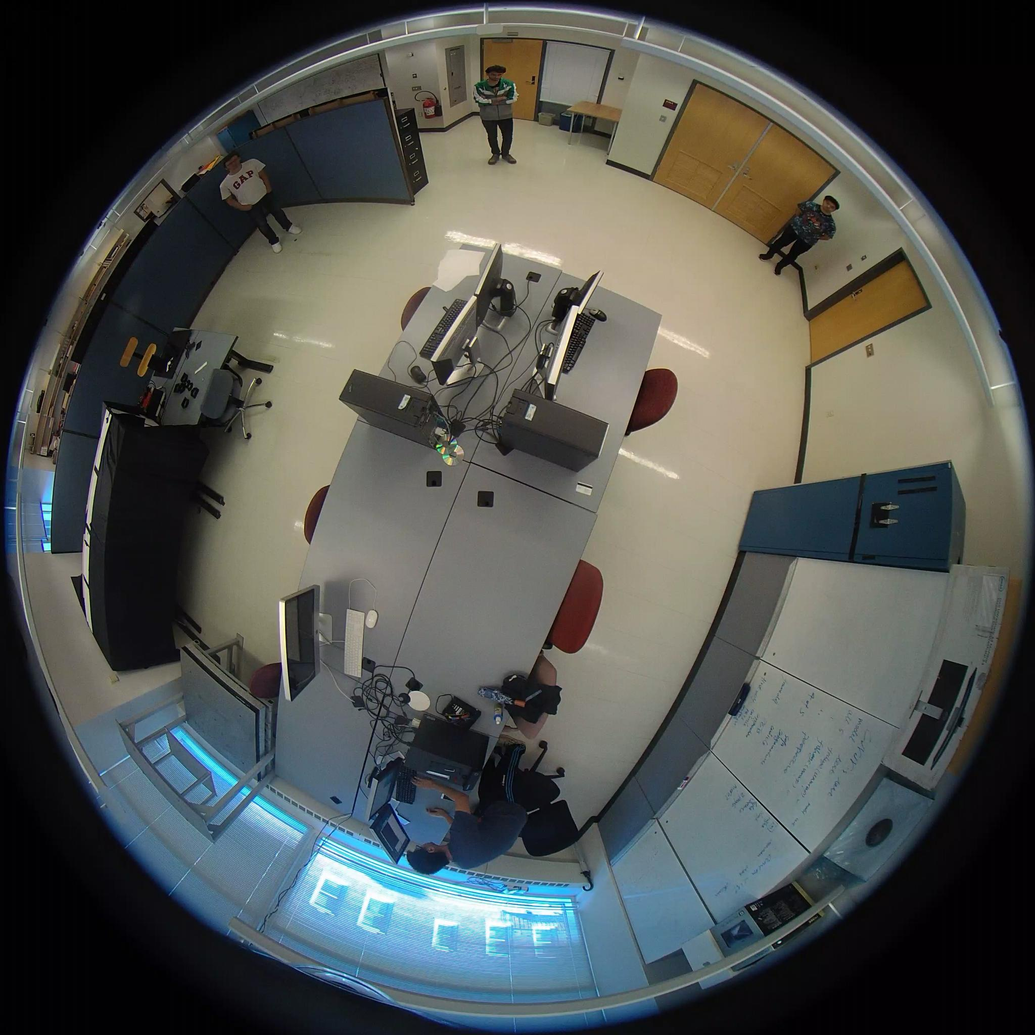
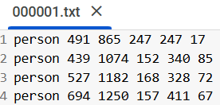
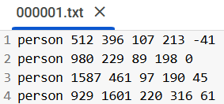
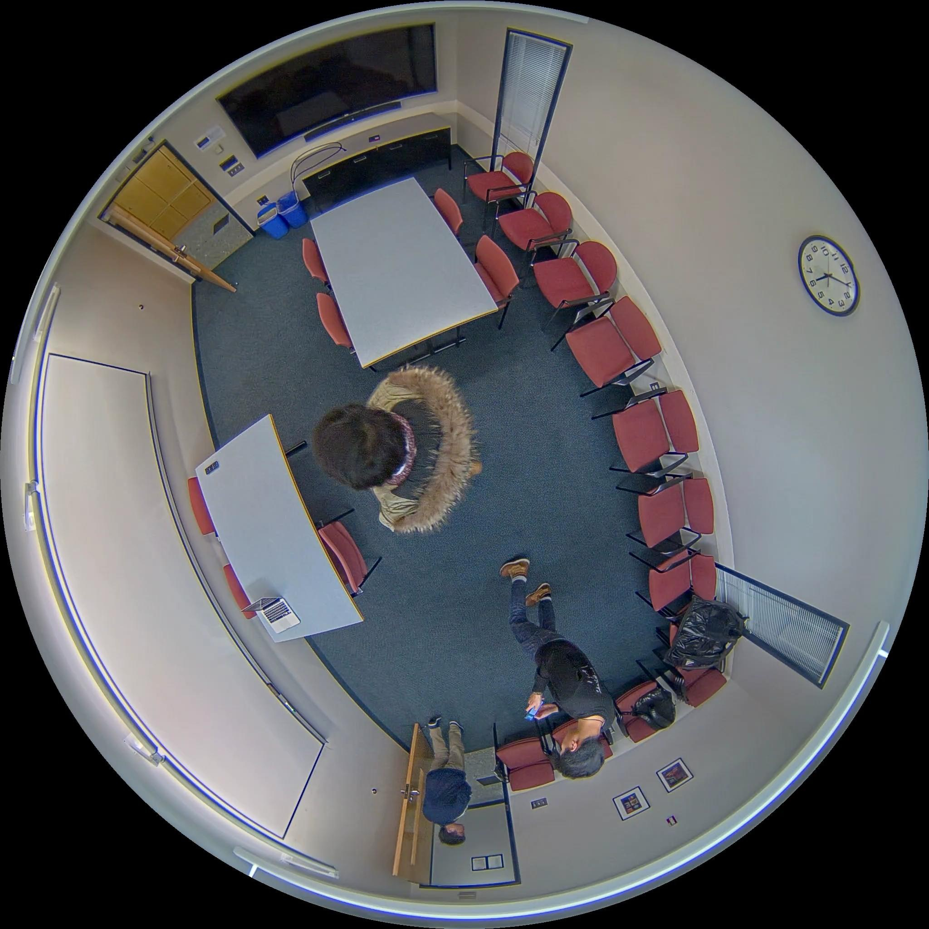
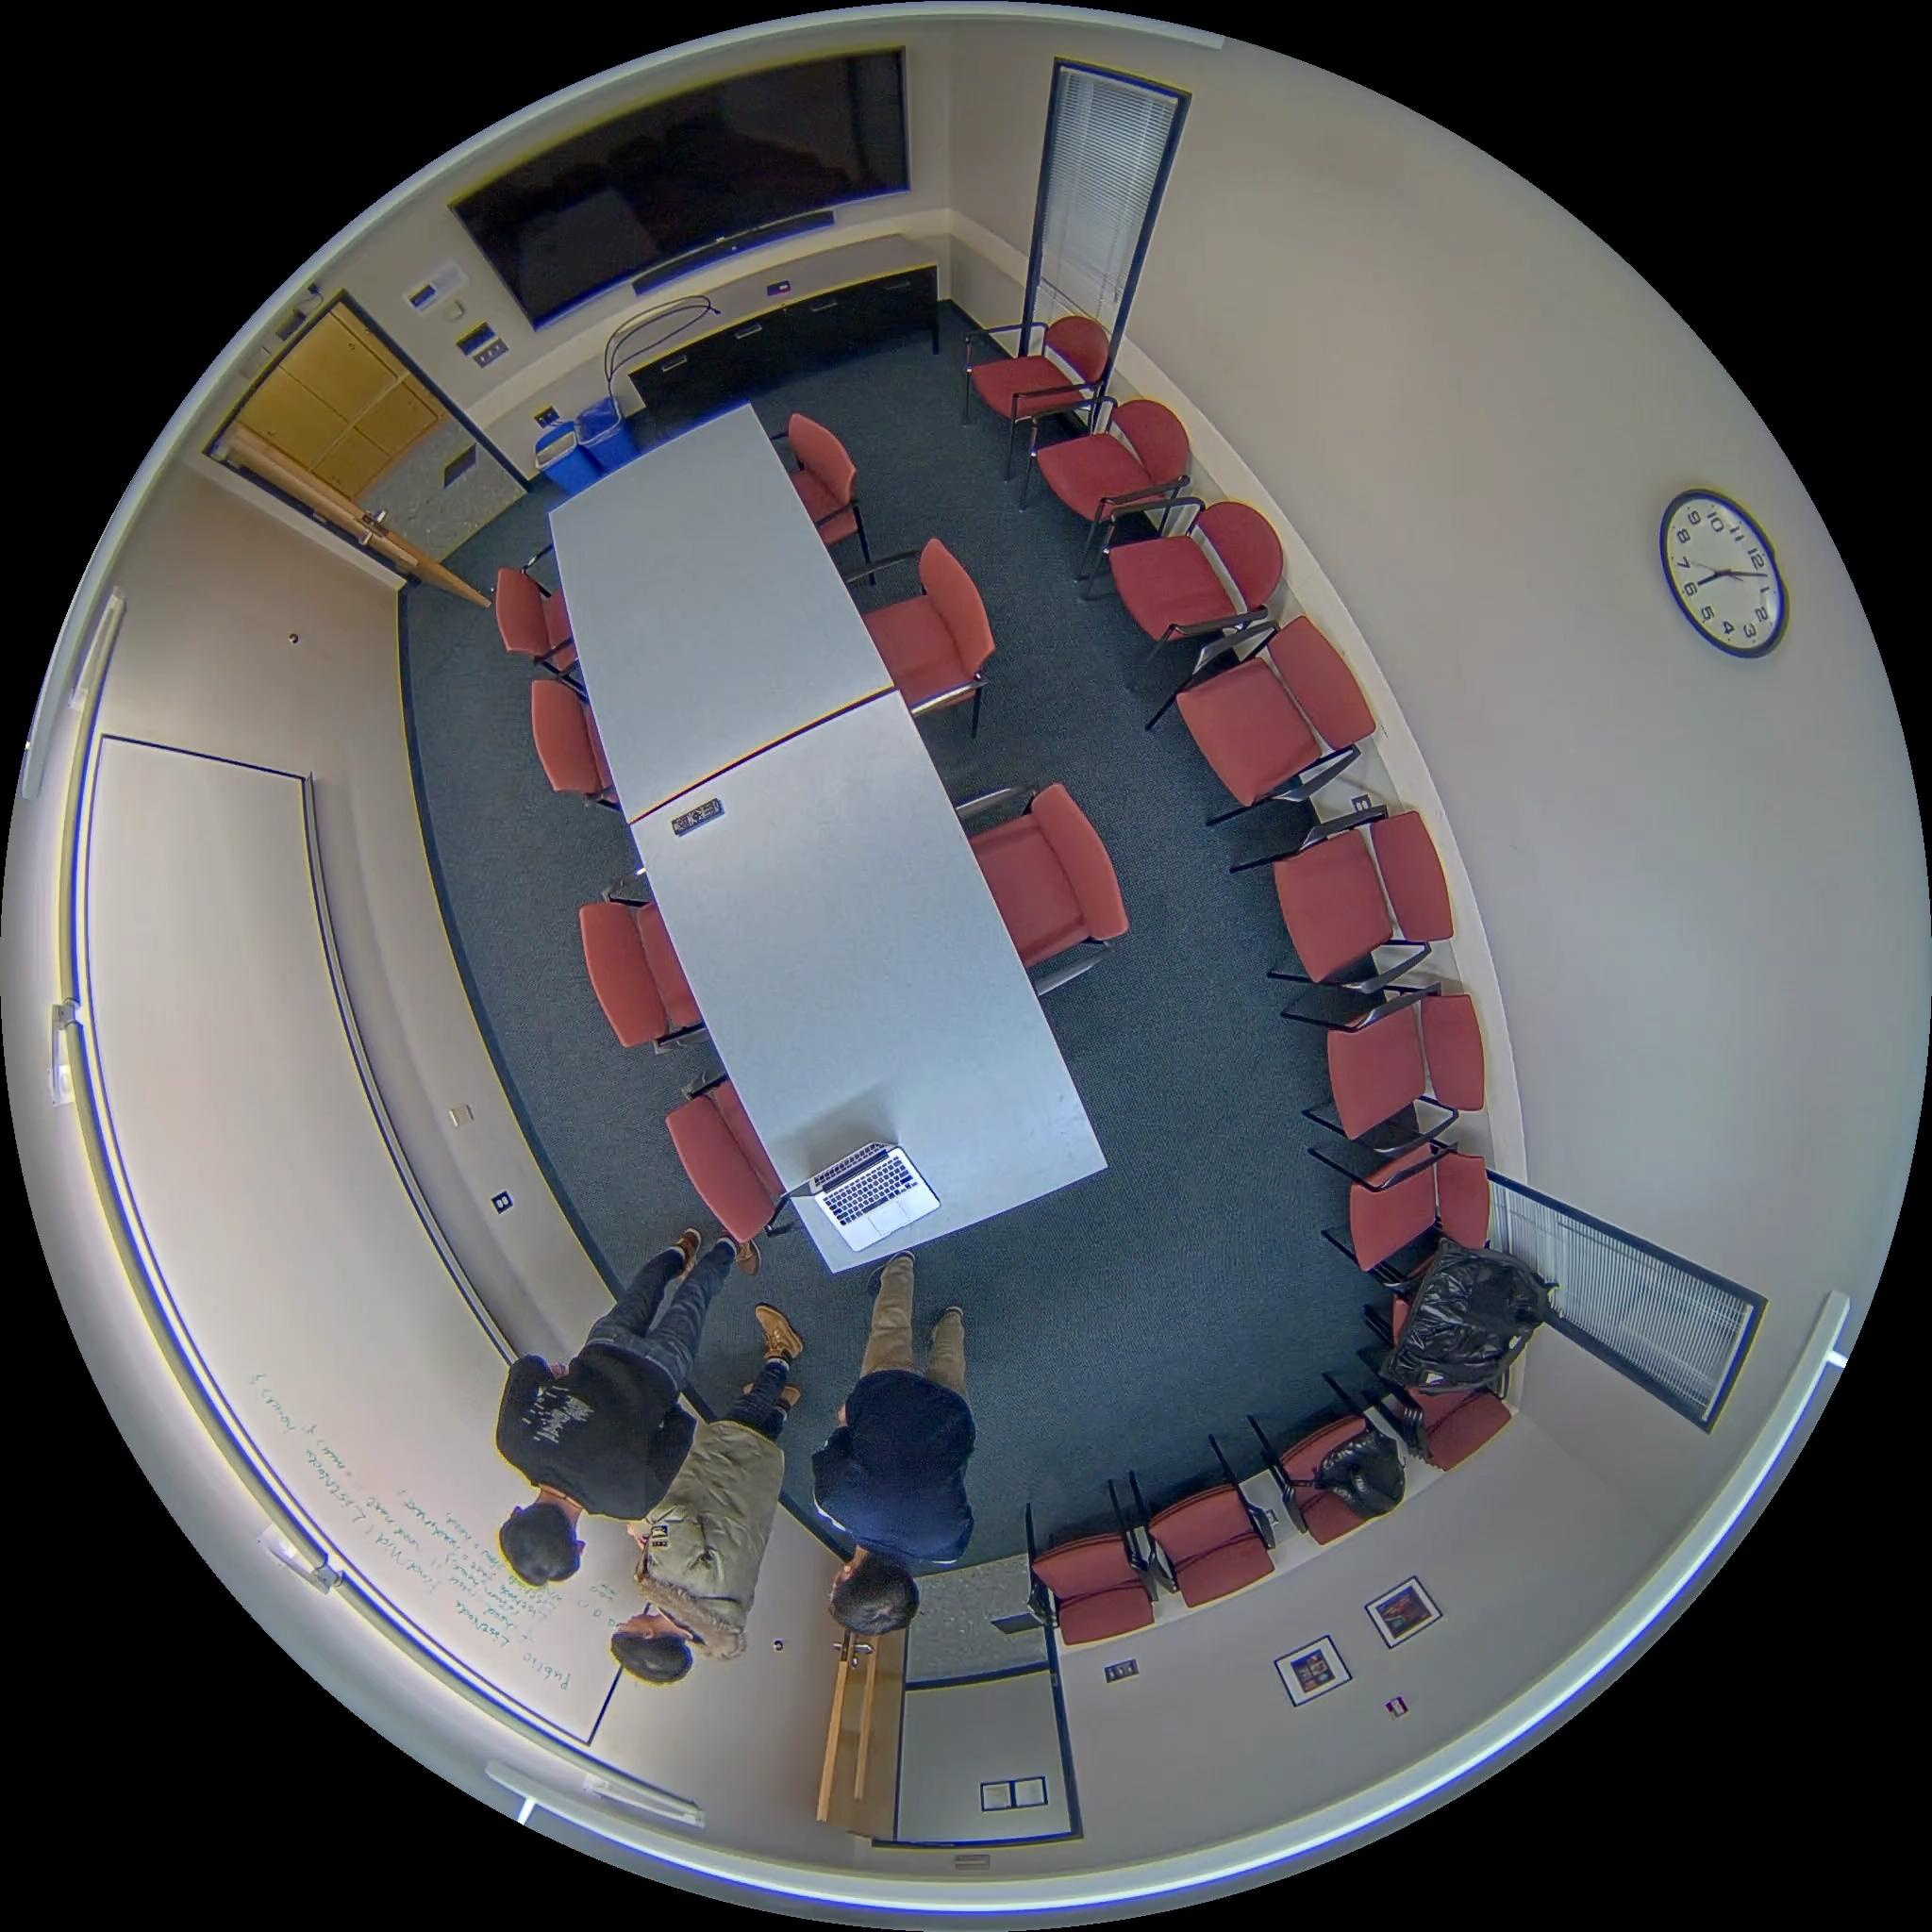
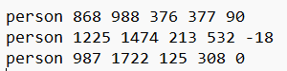
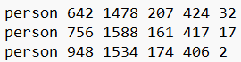
Lab1 Sample
Lab2 Sample
Box format: [class, x, y, width, height, rotation_angle] Rotation angle is between –90° and +90°
Boxes are body-aligned, not image-aligned
Challenges: – People blocking each other (occlusions) – Complex body positions – Lighting changes – People standing close together
Meeting1 Sample
Meeting2 Sample
14

Slide 6
Object Detection Models
1
YOLOv5
4
Custom CNN Backbones
Fast, efficient to train, and worked well out of the box on my classroom data.
Tested lightweight models, but none beat YOLO on speed + performance.
2
YOLOv8
5
MMDetection (Rotated Anchors)
Not as accurate as yolov5 on fisheye camera dataset
Tried manual anchor tuning — results were inconsistent.
3
YOLOv8-OBB
6
MMRotate – R3Det
Handled rotated people better, but slower and not ideal for real-time.
Best accuracy on rotated views, but it was complex for real-time on Jetson.

Slide 7
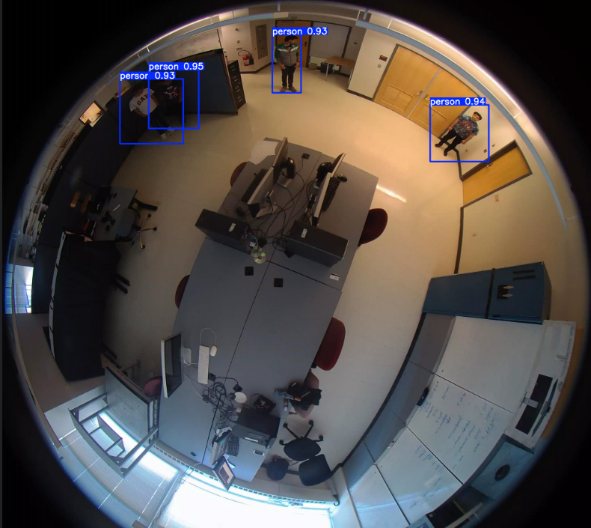
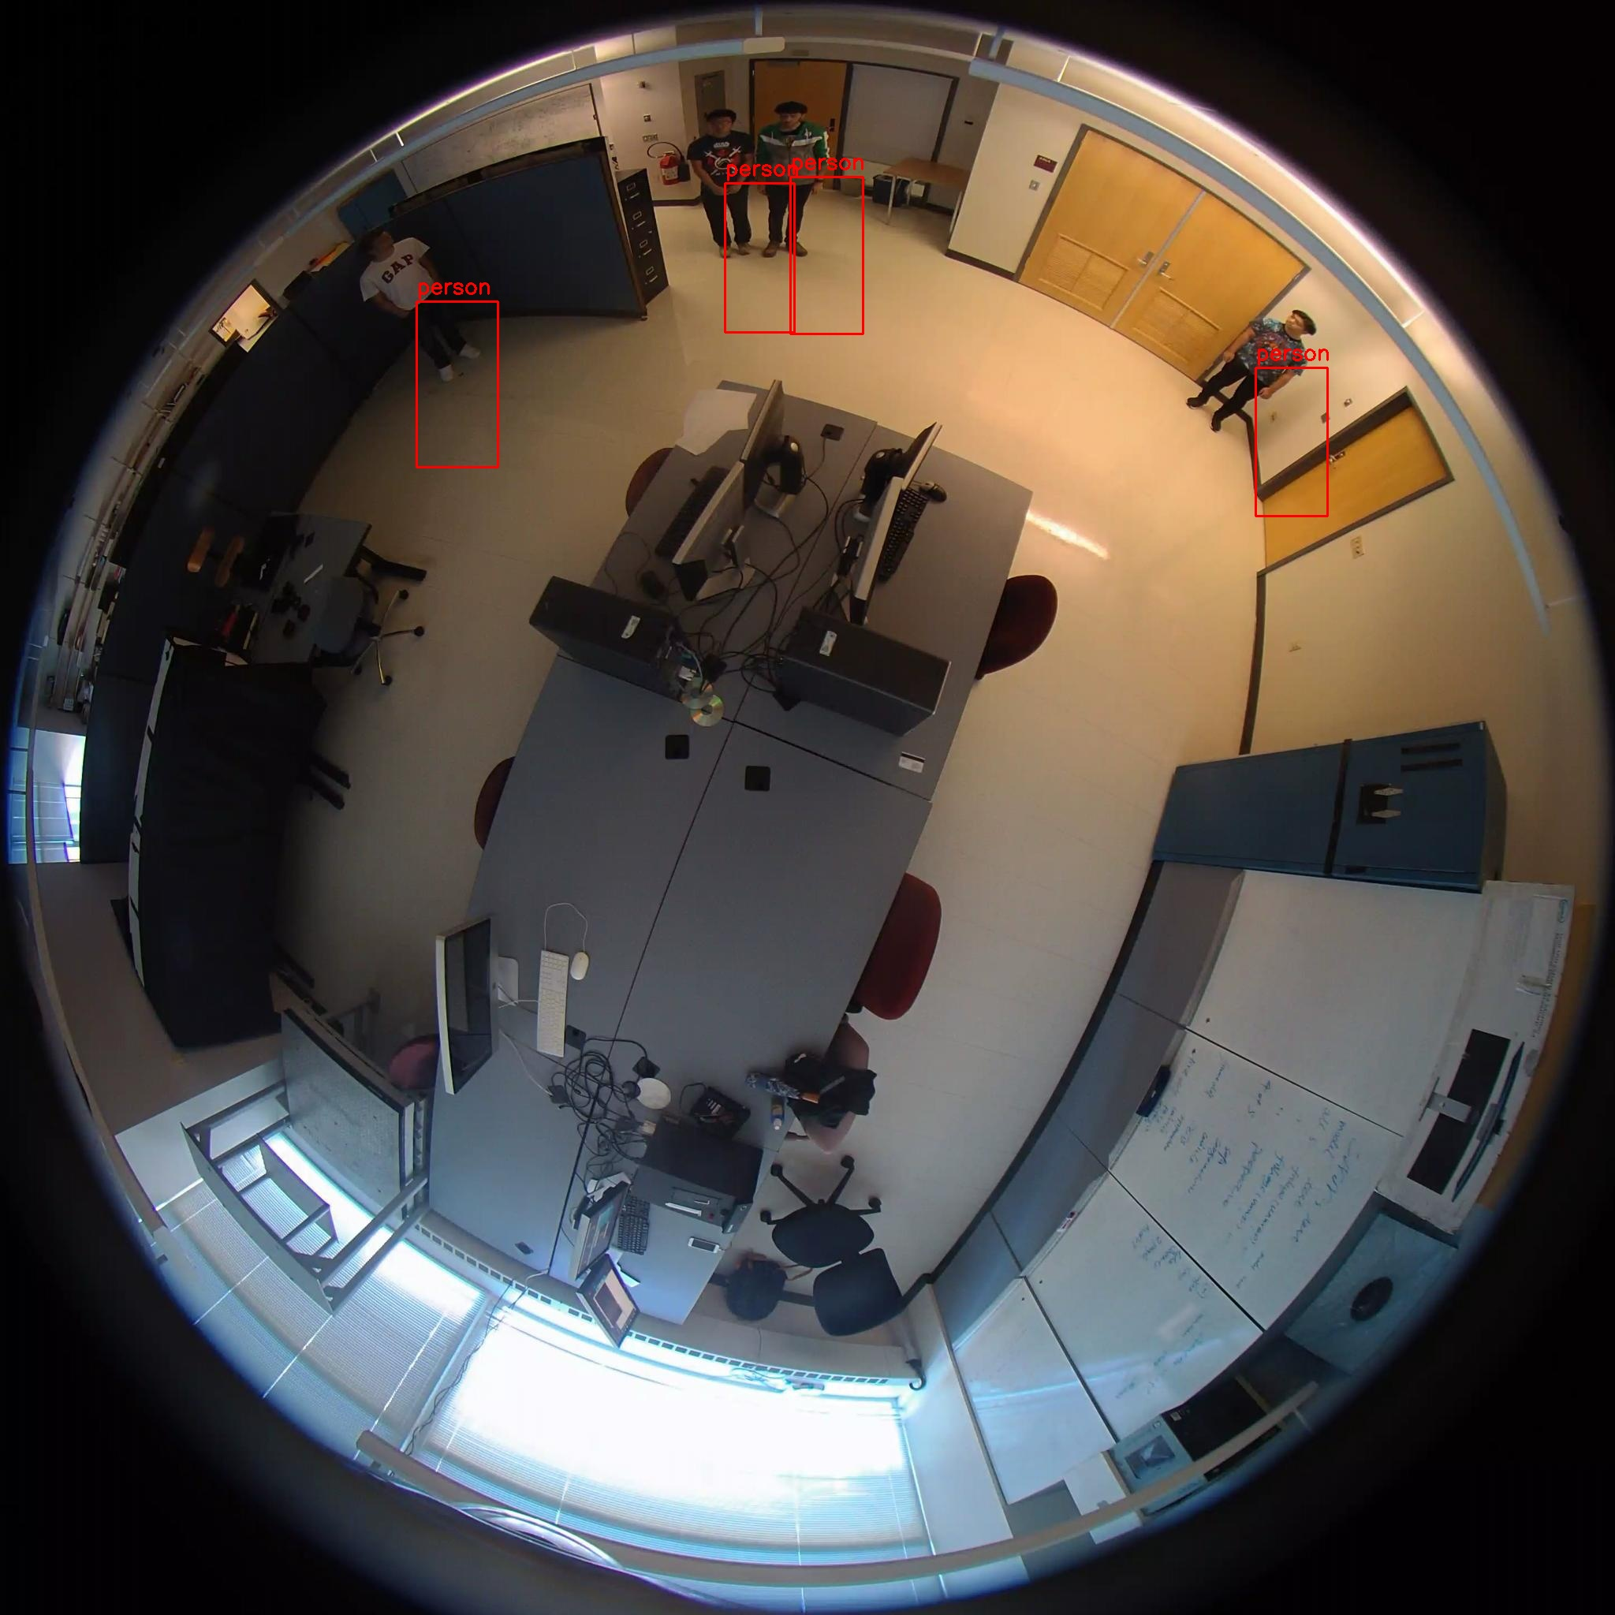
YOLOv5
YOLOv8

Slide 8
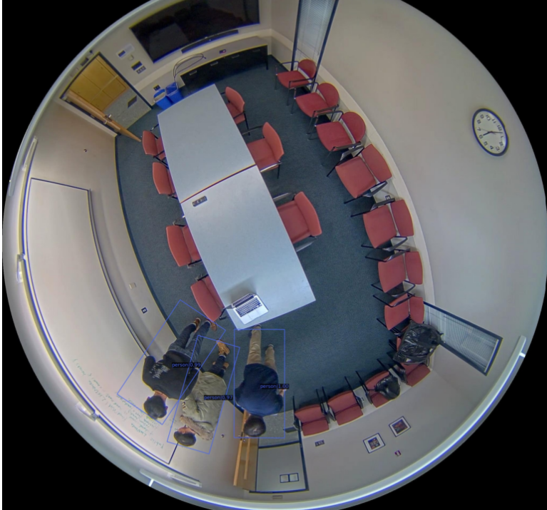
YOLOv5 VS MMRotate–R3Det
Specialized for Rotated Object Detection
1
1
High Accuracy after Label Fixing
Higher Detection Accuracy Compared to the Alternatives
2
2
Best Balance of Speed, Accuracy, and Ease of Integration
Complexity and Usability Issues
3
3
Fast and Lightweight

Slide 9
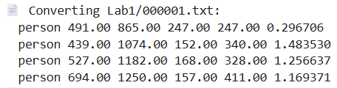
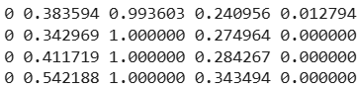
Labels
Original Label:
[class, x, y, width, height, rotation_angle]
After: MMRotate Label:
[class_name, x_center, y_center, width, height, angle_in_radians]
After: YOLOv5 Label:
[class, x_center_norm, y_center_norm, width_norm, height_norm]

Slide 10
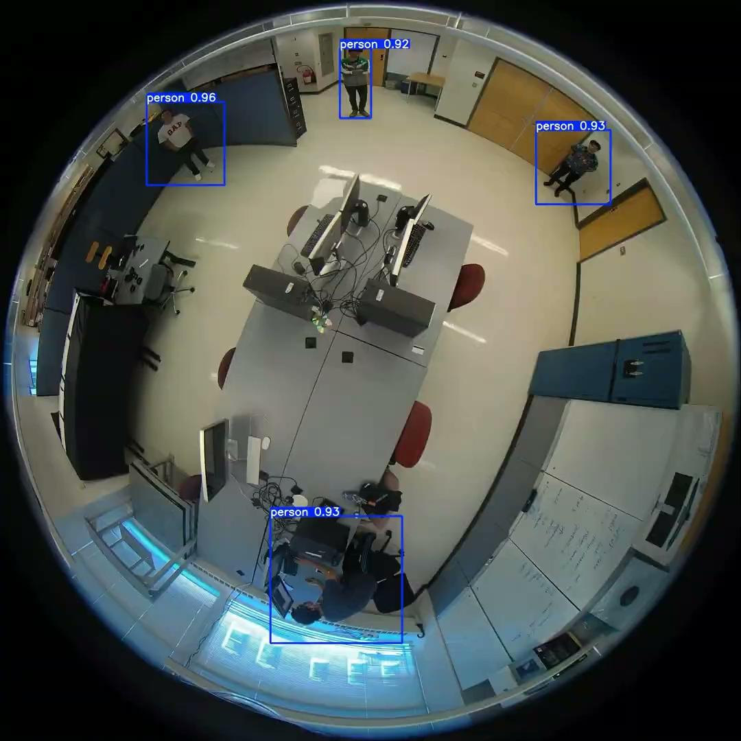
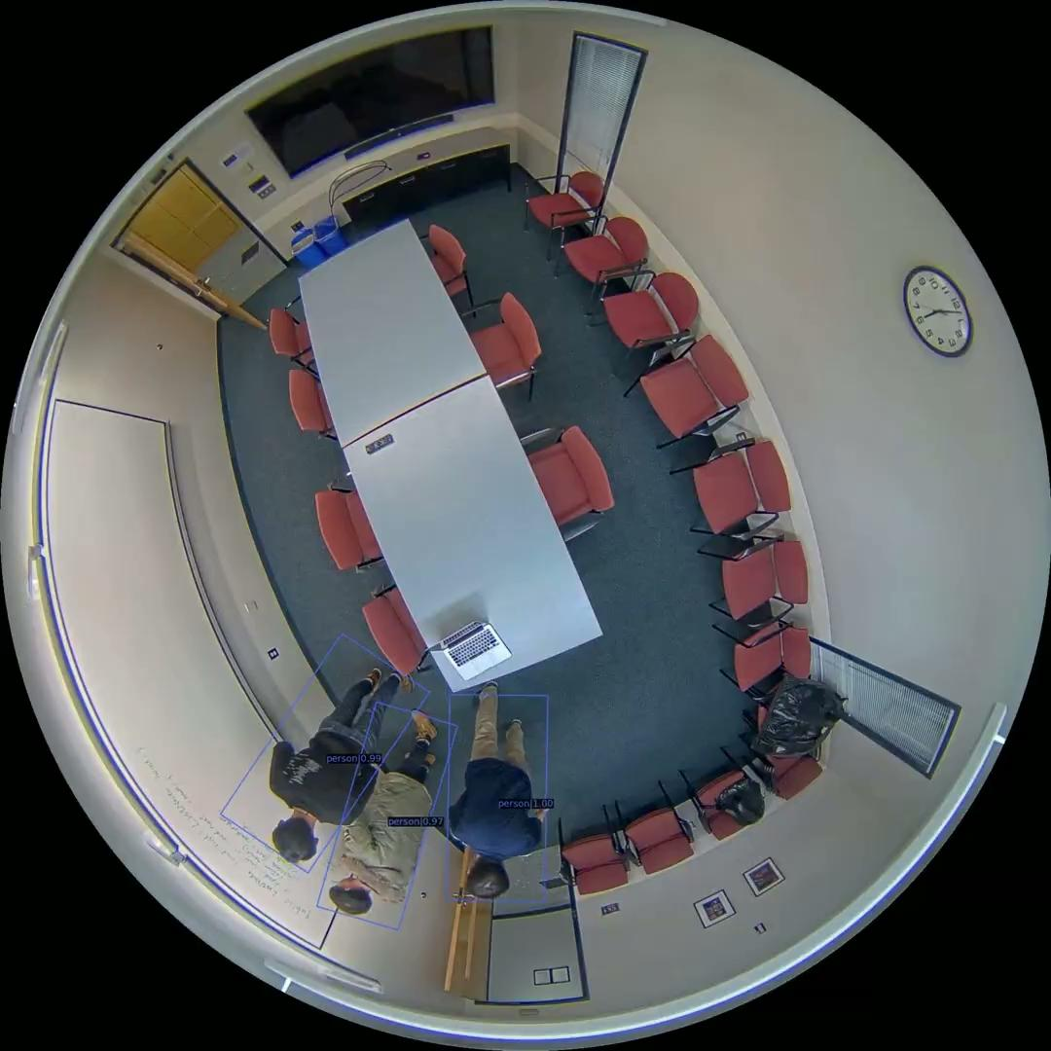
YOLOv5
MMRotate

Slide 11
Tracking Approaches
DeepSORT + supervision
ByteTrack + supervision
Cleaner tracking.
Distracting layout.
Struggled with ReID.
Cleaner layout.
Better ReID
Inaccurate tracking
DeepSORT (default)
2
3
DeepSORT + ReID + supervision
Jittery inaccurate tracks.
Frequent ID changes.
Clean tracking.
Clean layout.
Improved ReID
1
4

Slide 12
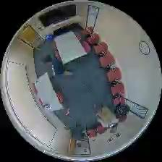
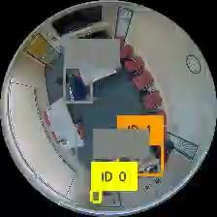
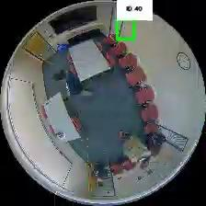
1st approach
2nd approach
3rd approach

Slide 13
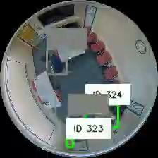
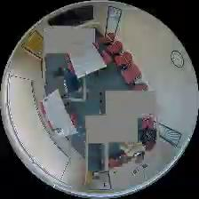
mmRotate
YOLOv5

Slide 14
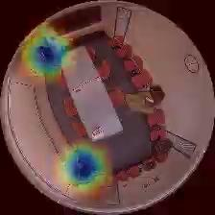
Heatmap Generation
Frame by Frame detections.
generating a 2D gaussian kernel on grid.
map is colored and normalized using OpenCV COLORMAP_JET.

Slide 15
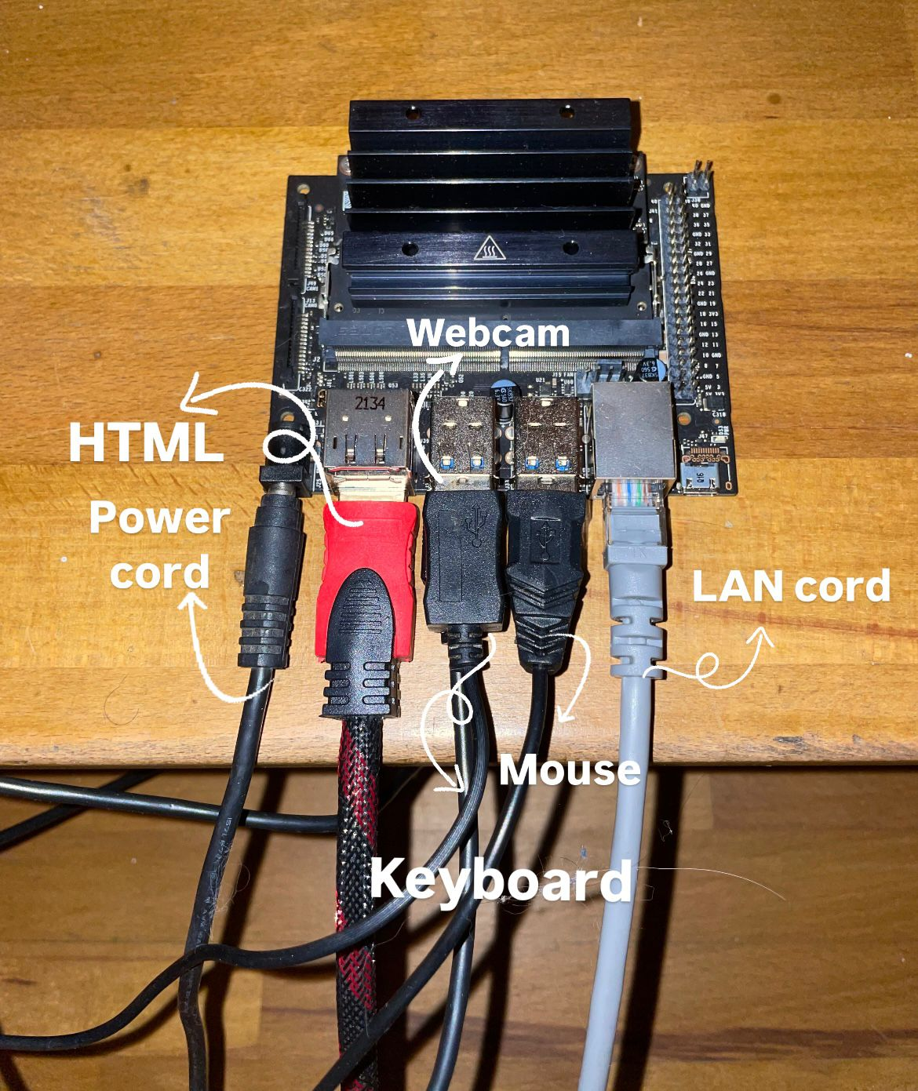
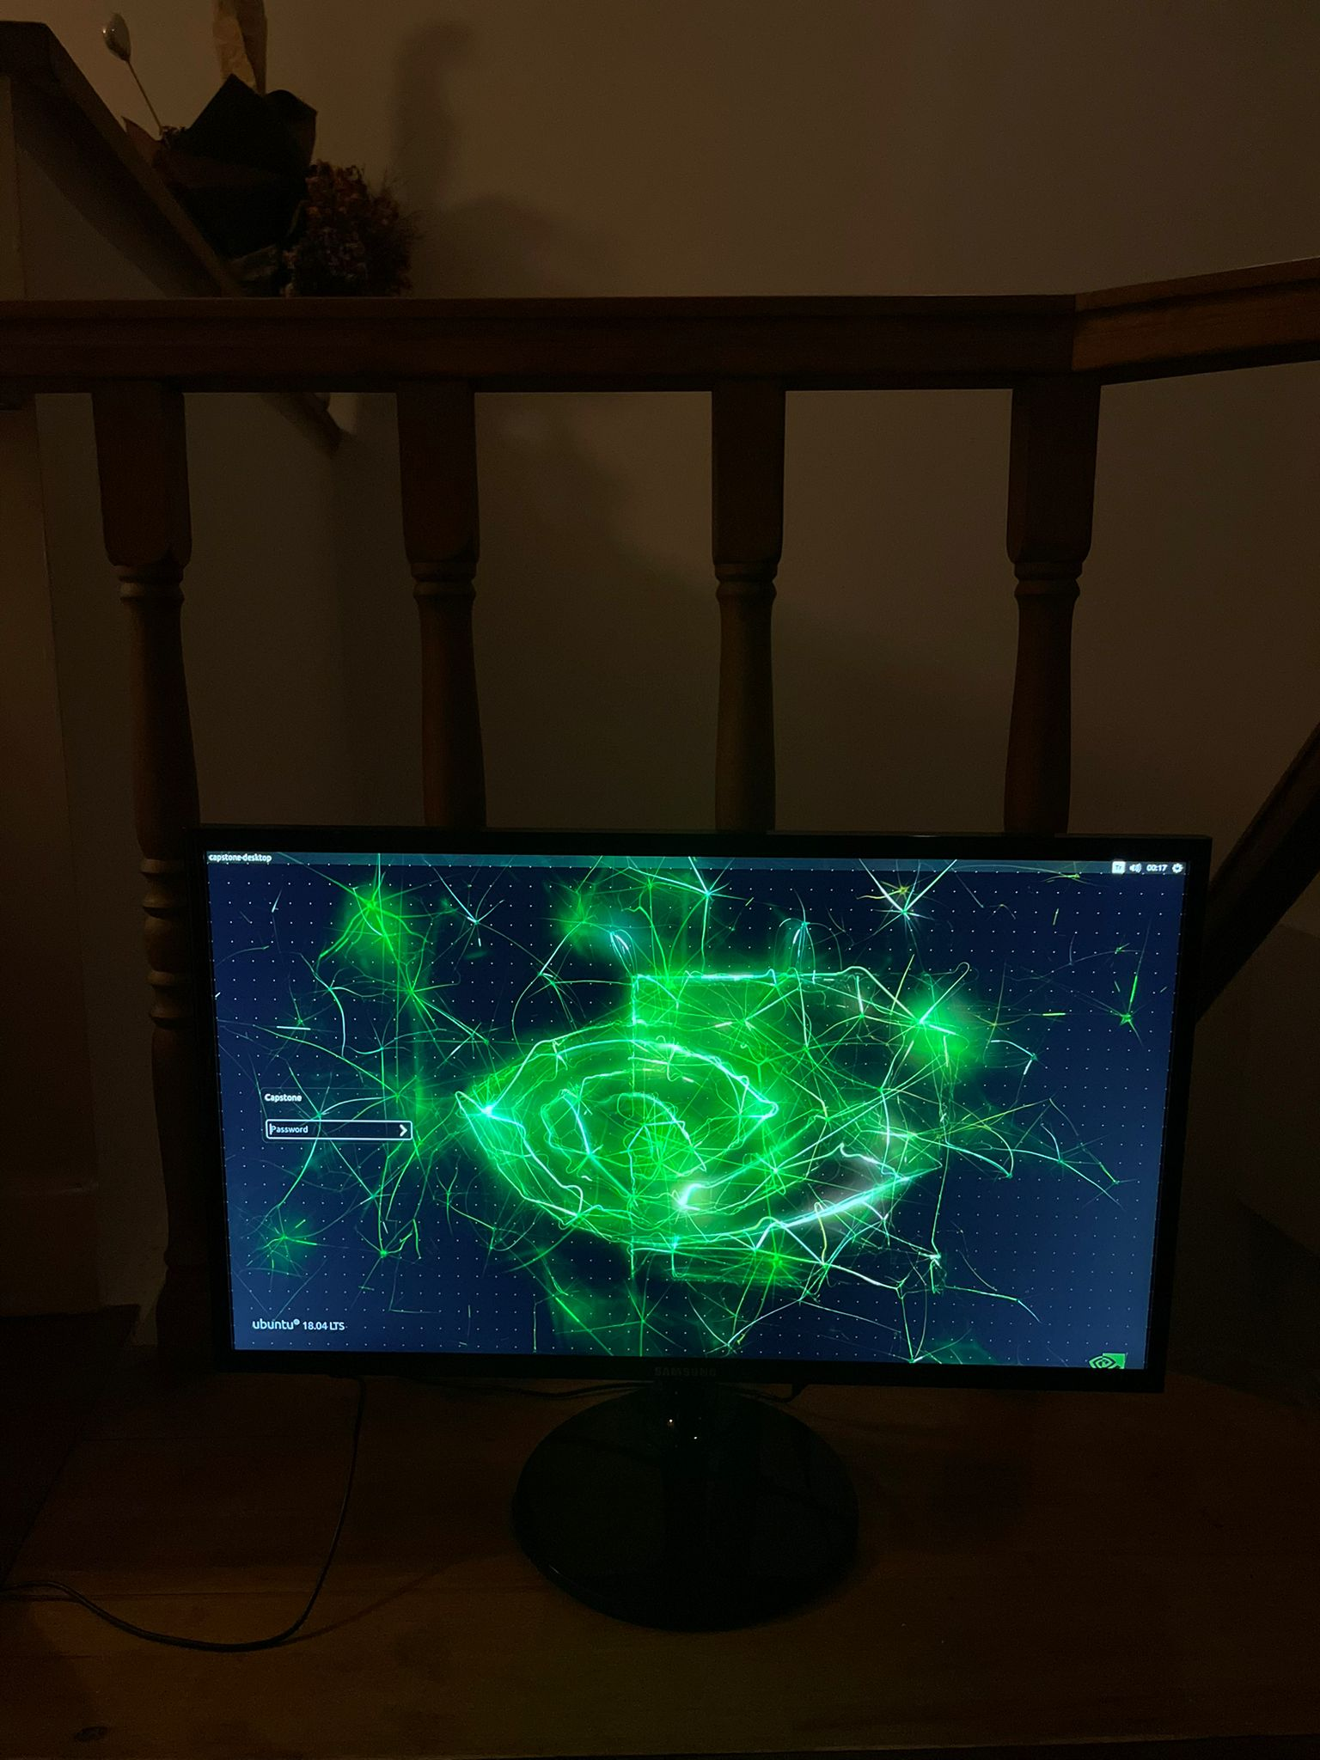
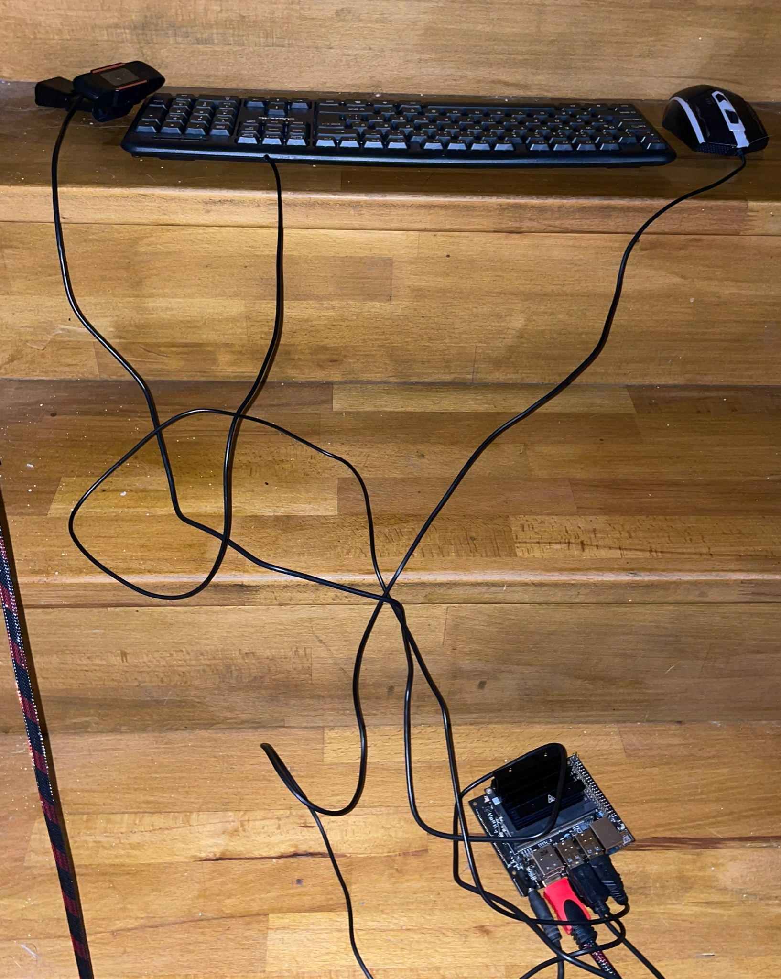

Slide 16
Methods Overview
All-in-One GPU Workstation (Flask)
Entire pipeline (YOLOv5/DeepSORT) on GPU machine; network‐stream to client
Outcome: version conflicts with project code, broke repository
HOG + DeepSORT on Laptop (Flask)
Switched to CPU‐friendly HOG detector on laptop, served via Flask API
Outcome: improved stability but still CORS & performance limitations
Client-Server via FastAPI & Browser
FastAPI on laptop receives JPEG frames, runs HOG + DeepSORT, returns JSON
HTML5 client captures webcam, POSTs every 200 ms, renders green boxes + IDs
Outcome: smooth 10 FPS tracking, zero crashes, easy Web deployment
YOLOv5 + DeepSORT on Jetson Nano (Flask)
Monolithic prototype: camera → Nano → Flask server → browser
Outcome: feed froze every few seconds under CPU/RAM load
GPU Inference + Nano Display (Flask)
Detection & tracking on desktop GPU, stream annotated frames to Nano
Outcome: Nano crashed on stream spikes, unstable rendering
ARM-Native Pipeline on Nano (Flask)
Recompiled OpenCV with CUDA, installed ARM PyTorch wheels, ByteTrack on Nano
Outcome: CUDA/PyTorch mismatches & segfaults—dependency hell

Slide 17
Integration Workflow
Data Flow:
1
2
3
Jetson Nano
PC server
Jetson Nano (Display)
AI Server (PC)
Runs full Python/OpenCV/YOLOv5 inference
Applies DeepSORT tracking & heatmap generation
Serves processed frames & analytics back over network

Slide 18
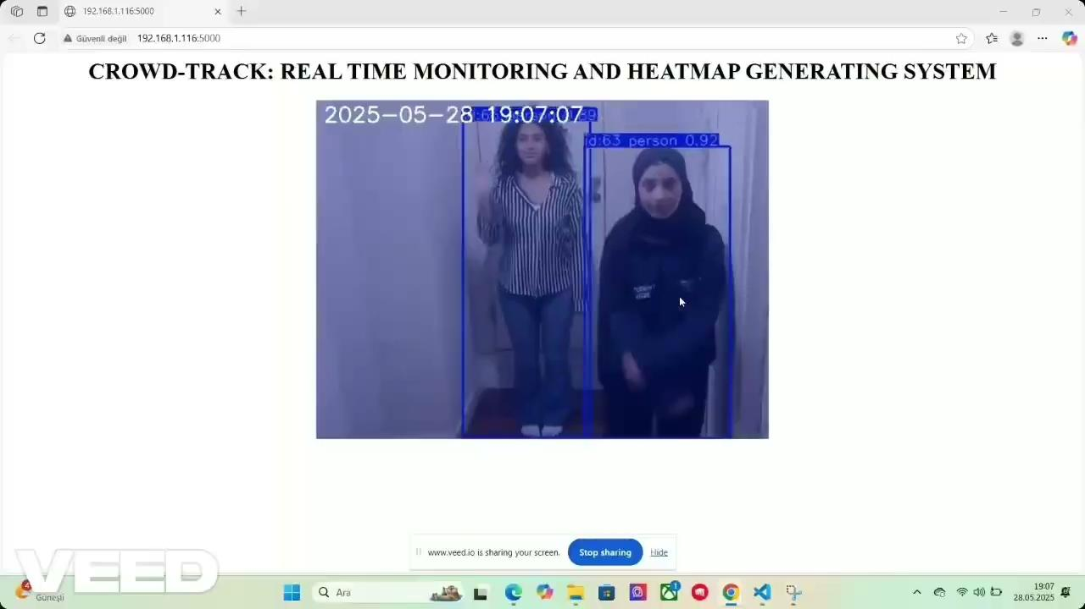
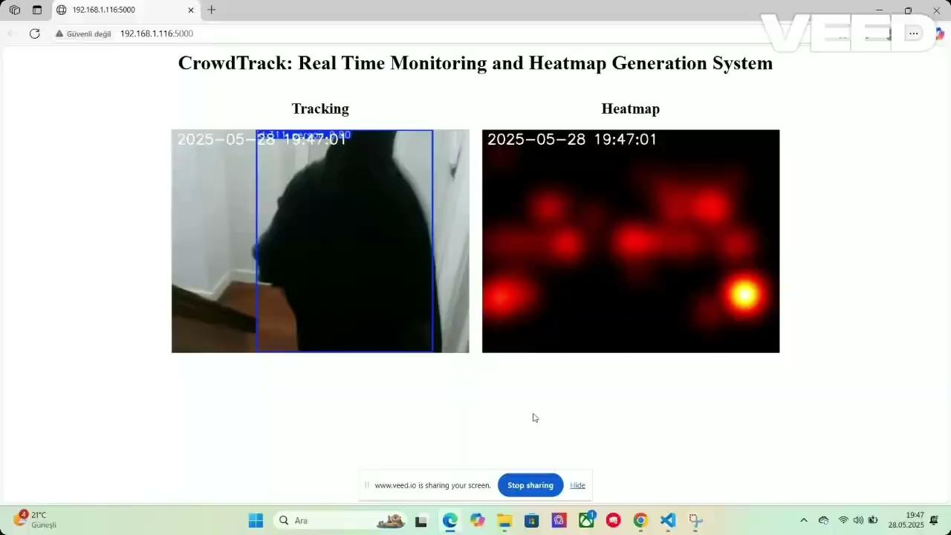
Heatmap Overlaid on Video
Heatmap Side-by-Side

Slide 19

Conclusion
Trained YOLOv5
Integrated with Nividia
Live Tracking
Created UI
Live Heatmap Generation

